Slide 1
Polymorphism
Course Code:
Course Title: Object Oriented Programming -1(JAVA)
Dept. of Computer Science
Faculty of Science and Technology
Lecturer No: |  | Week No: |  | Semester:
Lecturer: | Rifath Mahmud

Slide 2
Lecture Outline
Polymorphism
Method Overloading
Method Overriding
Constructor Overloading
Polymorphic Behavior of Objects

Slide 3
Polymorphism
Definition of Polymorphism
It means ‘Different Forms of the Same Thing’.
In other words ‘One Name, Different Forms’.
Real Life Example:

Slide 4
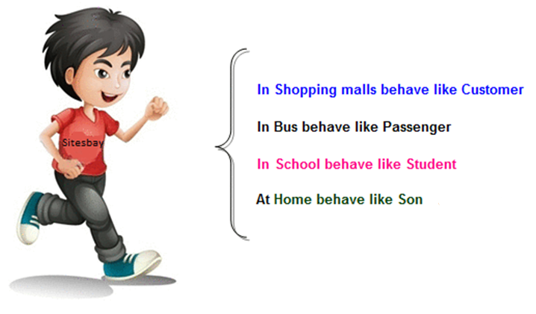
Example of Polymorphism

Slide 5
Example of Polymorphism
Let’s imagine another scenario, it is a very usual case that in a class (section) there are more than one student having the same name. But their work/activities are different. One may get scholarship, the other might be in probation.
So, in real life, we always see polymorphic behavior of humans.
In Programming the polymorphic behavior might be with methods, Constructors and Objects.
Method Overloading.
Method Overriding.
Constructor Overloading.
Polymorphic Behavior of Objects.

Slide 6
Method Overloading
As the name suggests, it happens among methods. There are some conditions of method overloading. If and only If these conditions are met, we can say that there are method overloading among those methods.
These conditions are:
Methods MUST be in same class.
Method Name MUST be same.
Method Parameter MUST be different.
Method Return Type may or may not be same.

Slide 7
Method Overloading - Example
public class MyClass{
public void add ( ){. . .}
public void add(int a) {. . .}
public void add (int a, int b) {. . .}
public void add (int a, int b, int c) {. . .}
public void add (double a, double b) {. . .}
public double add (int a, double b) {. . .}
public void add (double a, int b) {. . .}
//public int add(int x) {. . .}
}
public class YourClass{
public void add( ){. . .}
public void add(int a) {. . .}
}

Slide 8
Method Overloading - Example
public class MyClass{
public void add( ){. . .}
//public void add(int a) {. . .}
public void add(int a, int b) {. . .}
public void add(double a, double b) {. . .}
public void add(int a, double b) {. . .}
public void add(double a, int b) {. . .}
public int add(int a) {. . .}
}
public class YourClass{
public void add( ){. . .}
public void add(int a) {. . .}
}

Slide 9
Method Overriding
Again, it happens among methods. There are some conditions of method overriding. If and only If these conditions are met, we can say that there are method overriding among those methods.
These conditions are:
Methods MUST be in two different classes.
There MUST be inheritance between the two classes.
Method Name MUST be same.
Method Parameter MUST be same.
Method Return Type MUST be same.

Slide 10
Method Overriding - Example
public class Alpha{
public void show( ){. . .}
public void print( ){. . .}
}
public class Bravo extends Alpha{
public void show( ){. . .}
public void print(int a){. . .}
}
public class Charlie extends Alpha{
public void show(int a){. . .}
public void print( ){. . .}
}
public class Delta{
public void show( ){. . .}
public void print( ){. . .}
}

Slide 11
Constructor Overloading
As the name suggests, it happens among Constructors. There are some conditions of constructor overloading. If and only If these conditions are met, we can say that there is constructor overloading in that class. These conditions are:
Constructors MUST be of same class.
Constructor Parameter MUST be different.

Slide 12
Constructor Overloading - Example
Just look at all the classes we have written this far. All of them has two constructors. One is Empty and the other is Parameterized.

Slide 13
About Objects
Before starting, let us go back to the statement:
Box b = new Box( );
Where is the Object?
Constructor Call for Object Creation
Class Name
Object Name
New keyword for memory allocation

Slide 14
About Objects
Box b = new Box( );
Where did we hear the term ‘Object Reference before’?
Box b1; //Object Reference Declaration
b1 = new Box( ); //Object Creation
Box b2 = new Box( ); //Object Creation
new Box( ); //Anonymous Object
Class Name
Object Reference
Object

Slide 15
About Objects
What is Anonymous Object?
  An Object without any Name
  new Box( );
So, Anonymous object can be used if and only if the object is required for just one time.
length | 1.5
width | 0.0
height | 0.0
  new Box( ).setLength(1.5);
  new Box( ).setWidth(1.2);
length | 0.0
width | 1.2
height | 0.0

Slide 16
Polymorphic Behaviour of Objects
According to the Polymorphic Behavior of Objects, An Object Reference of Parent Class can hold an Object of a Child Class.
Before going for an example, let’s assume the following Inheritance Tree:
Person
Employee
Student
Faculty

Slide 17
Polymorphic Behaviour of Objects
From the Inheritance tree, we can write the following statements:
Person p = new Person( );
Employee e = new Employee( );
Faculty f = new Faculty( );
Student s = new Student( );
Person
According to polymorphic behavior of objects, we can also write the following statements:
Person p1 = new Employee( );
Person p2 = new Faculty( );
Person p3 = new Student( );
Employee e1 = new Faculty( );
But we can not write the following statements:
Employee e2 = new Student( );
Student s2 = new Faculty( );
Employee
Student
√
Faculty
√
X

Slide 18
Polymorphic Behaviour of Objects
Why is it necessary?
  Lets have a look on the following class diagrams:

Slide 19
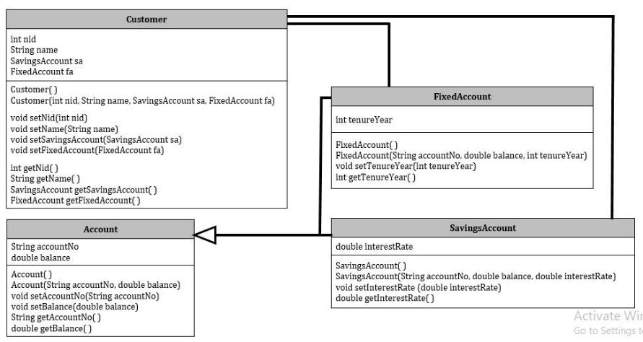
Polymorphic Behaviour of Objects
HAS A
HAS A
IS A

Slide 20
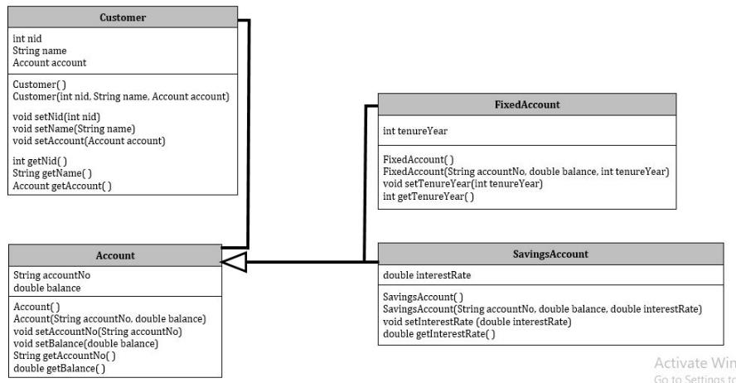
Polymorphic Behaviour of Objects
HAS A

Slide 21
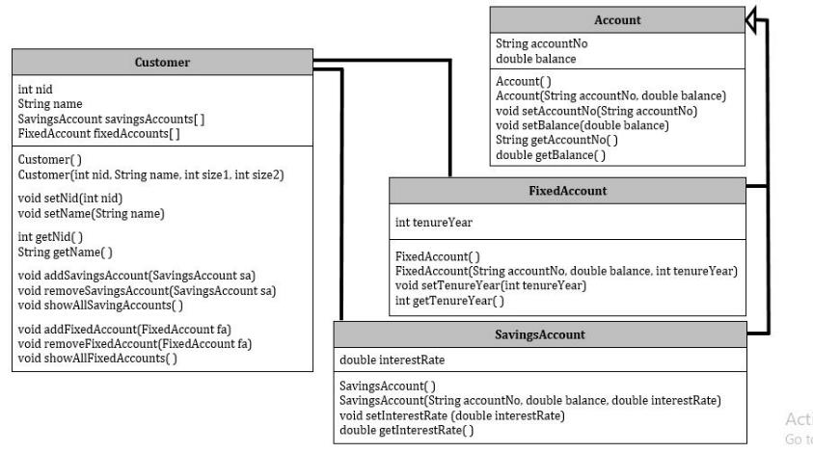
Polymorphic Behaviour of Objects
HAS
HAS

Slide 22
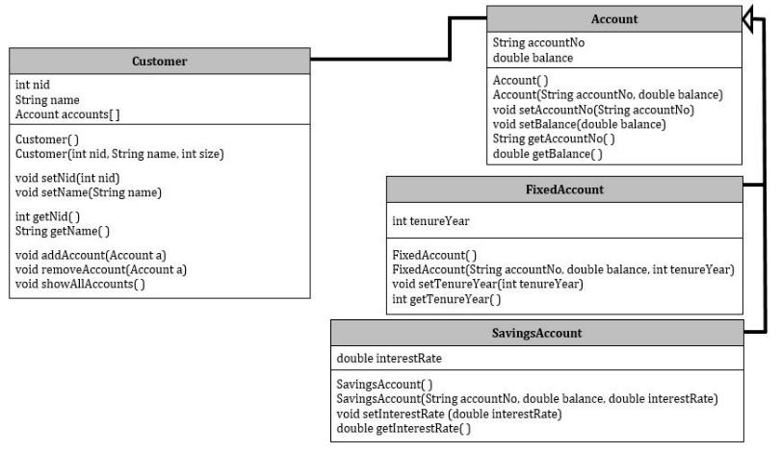
Polymorphic Behaviour of Objects
HAS

Slide 23
Example of Polymorphism
accounts = new Account [5];
Account a1 = new SavingsAccount(1111, 2500.0, 3.75);
Account a2 = new FixedAccount(2222, 3500.0, 10);
accounts[0] = a1;
accounts[1] = a2;
accountNo | 1111
balance | 2500.0
interestRate | 3.75
accountNo | 2222
balance | 3500.0
tenureYear | 10
 |  | null | null | null
0 | 1 | 2 | 3 | 4

Slide 24
Books
1. Java Complete Reference, 7th Edition, By Herbert Schildt.
2. A Programmer's Guide to Java SE 8 Oracle Certified Associate, Khalid A. MughalRolf W. Rasmussen
3. Java How to Program Java, 9th Edition, By Deitel and Deitel.
4. The Java Language Specification, By J. Gosling, B. Joy, G. Steele, G.Bracha and A. Buckley
5. Introduction to Programming Using Java, 6th Edition, By David j. Eck
6. Head First Java, By Kathy Sierra and Bert Bates

Slide 25
References
1. 1. Java Complete Reference, 7th Edition, By Herbert Schildt.
2. A Programmer's Guide to Java SE 8 Oracle Certified Associate, Khalid A. MughalRolf W. Rasmussen
2. The Java Tutorials. http://docs.oracle.com/javase/tutorial/

